Slide 1
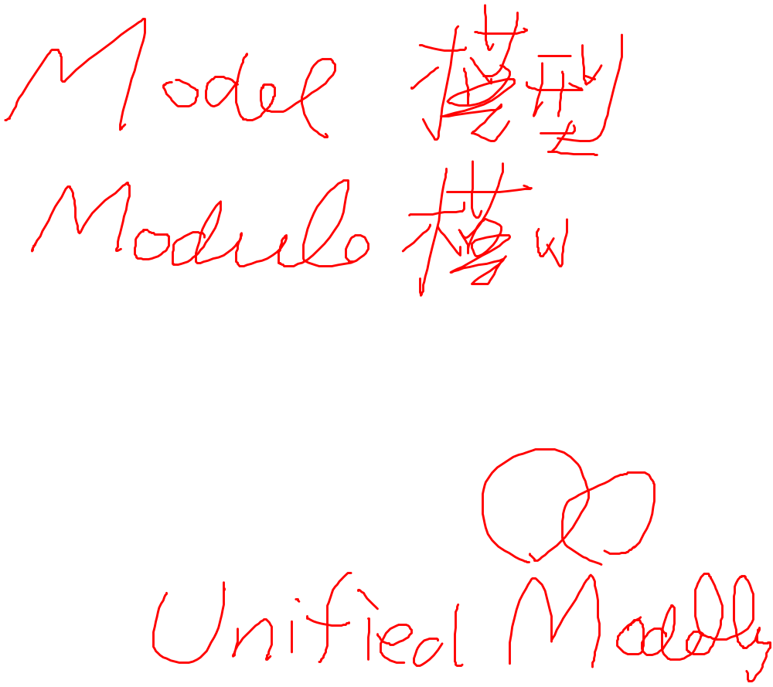

An overview of UML

Slide 2
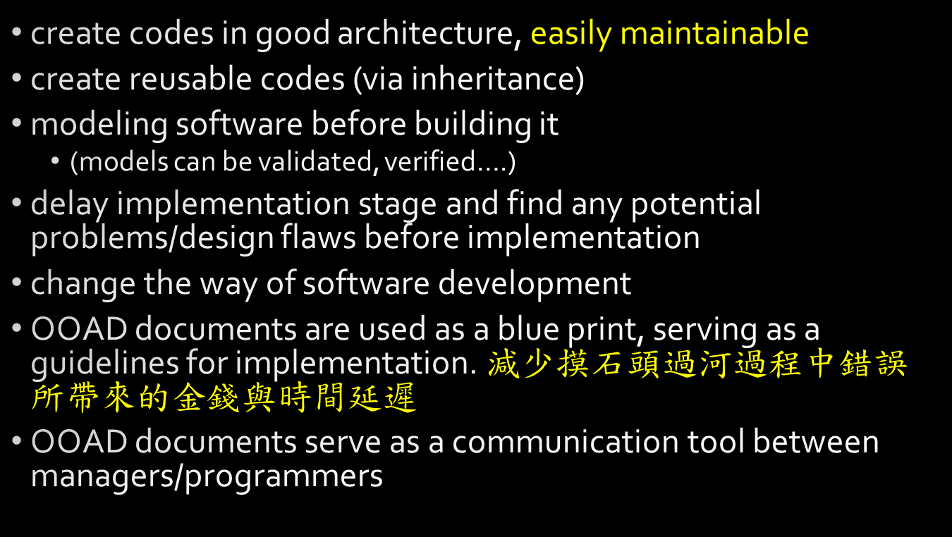

The objectives of OOAD

Slide 3
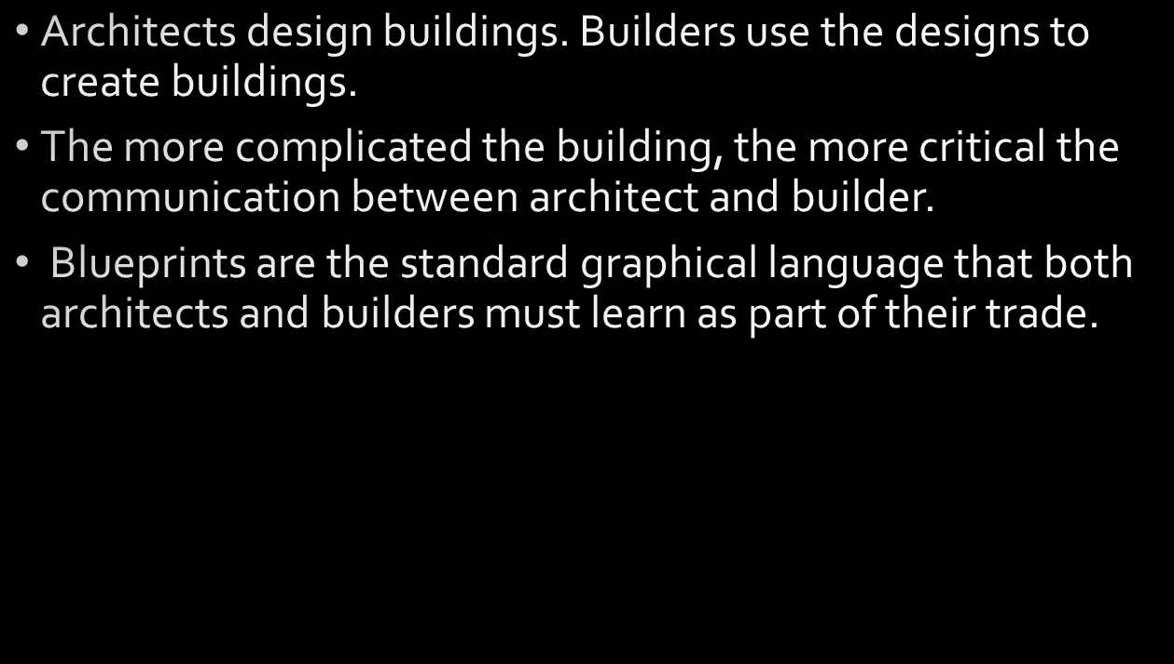

What UML is aimed for

Slide 4
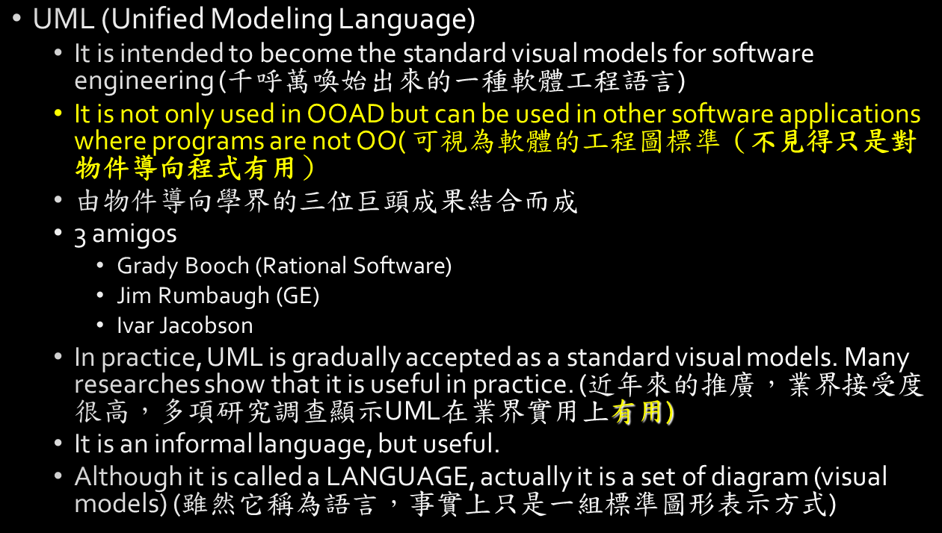

OOAD standard language UML

Slide 5


UML’s goal

Slide 6
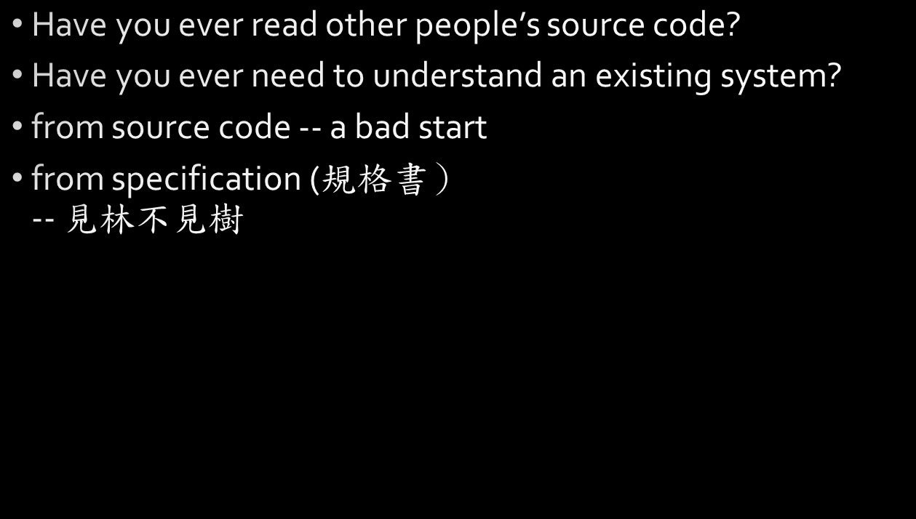

UML ─ A design and analysis language for communication

Slide 7
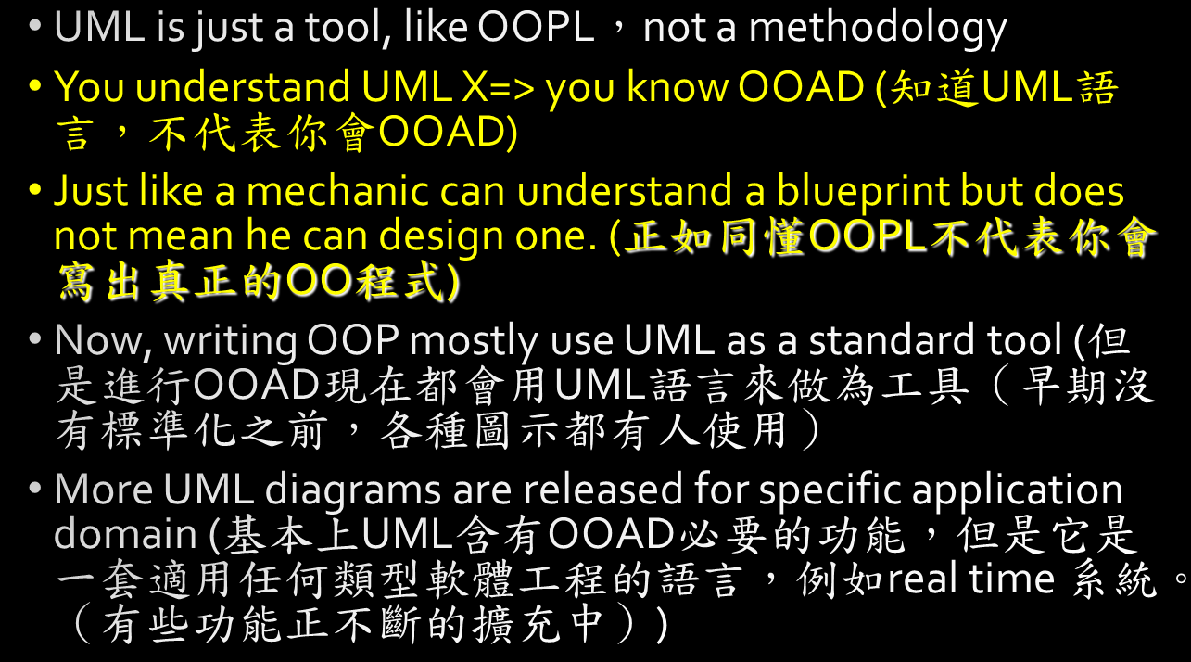

NOTES

Slide 8
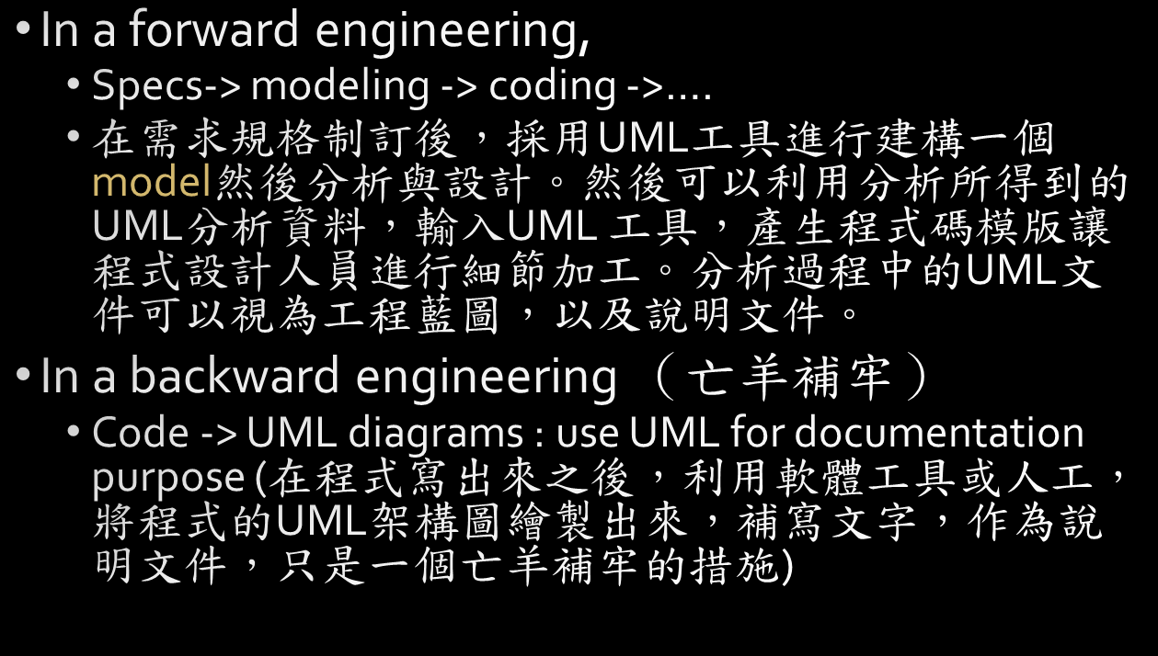

When to use it

Slide 9


How to use it

Slide 10
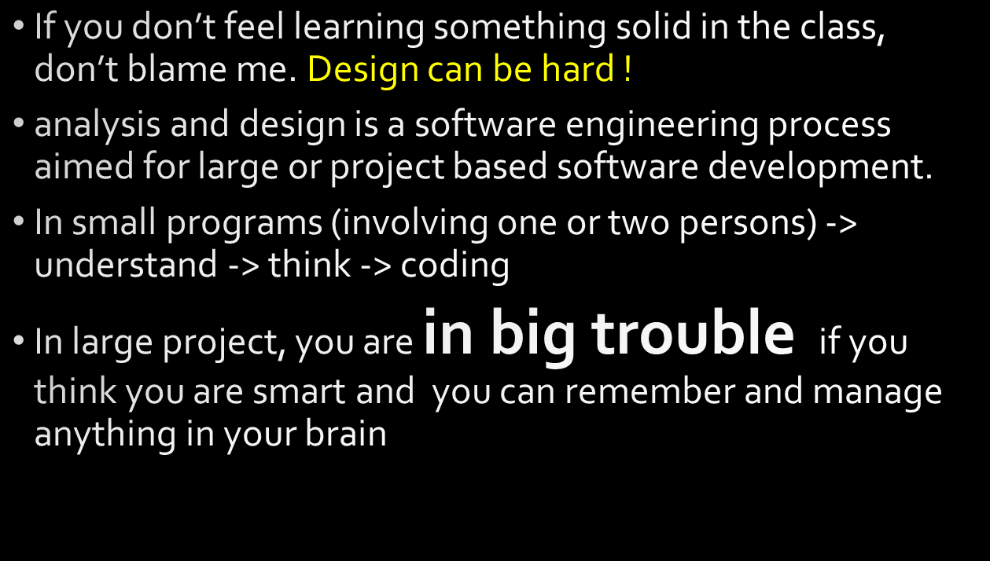

What is analysis and design?

Slide 11


The right time to get training of SE or OOAD

Slide 12
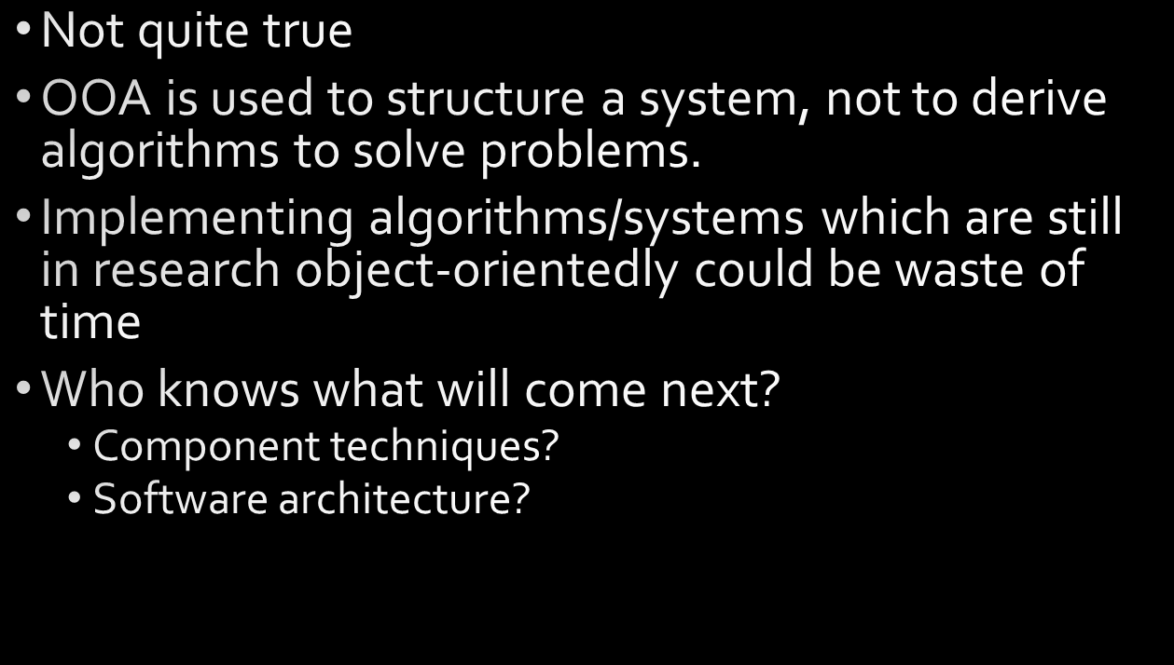

Is everything must be OO?

Slide 13
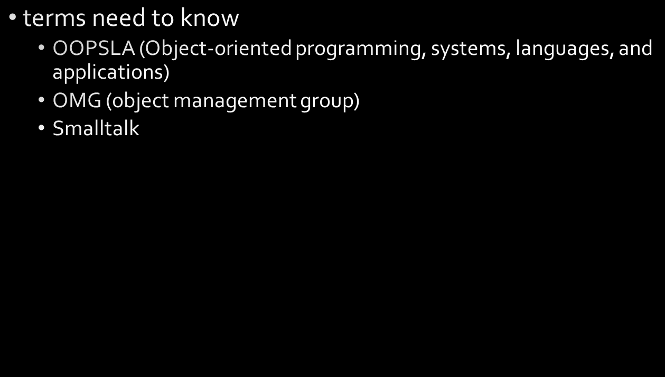

UML history

Slide 14
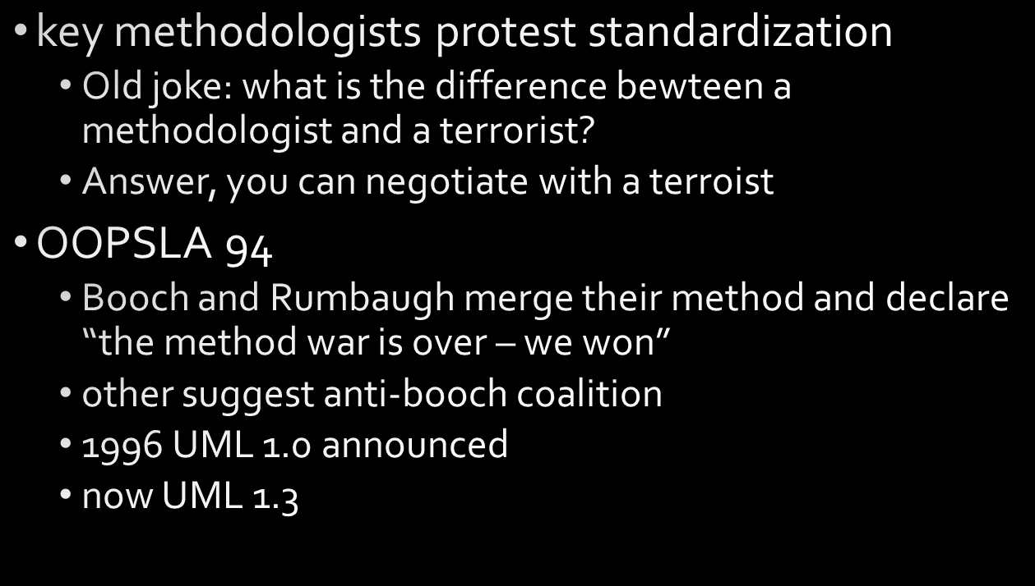

History of UML

Slide 15
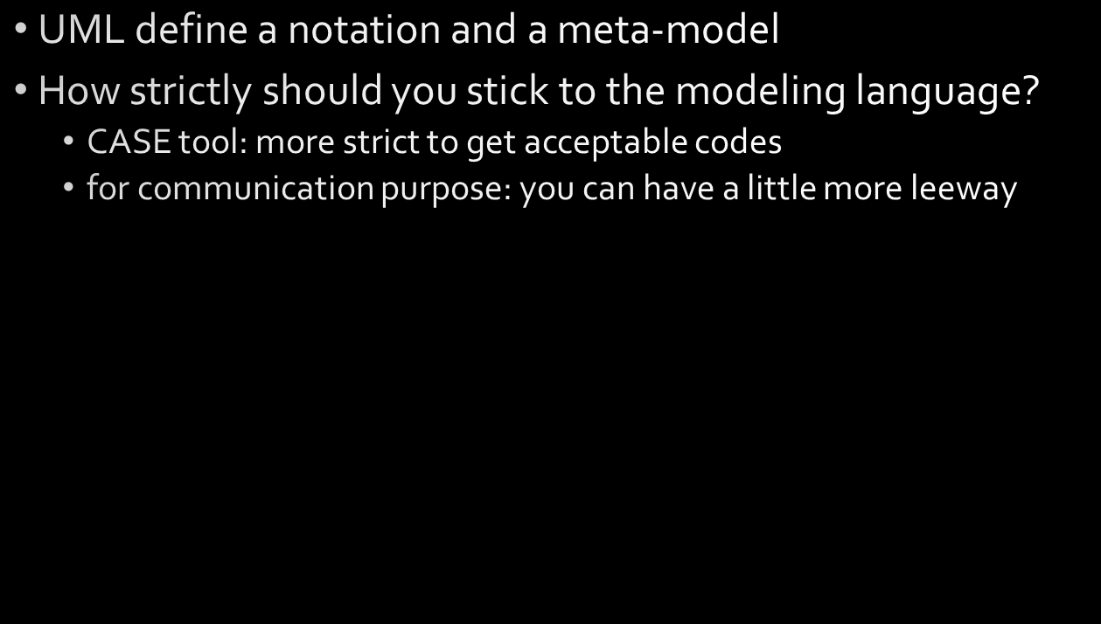

UML, a modeling language

Slide 16
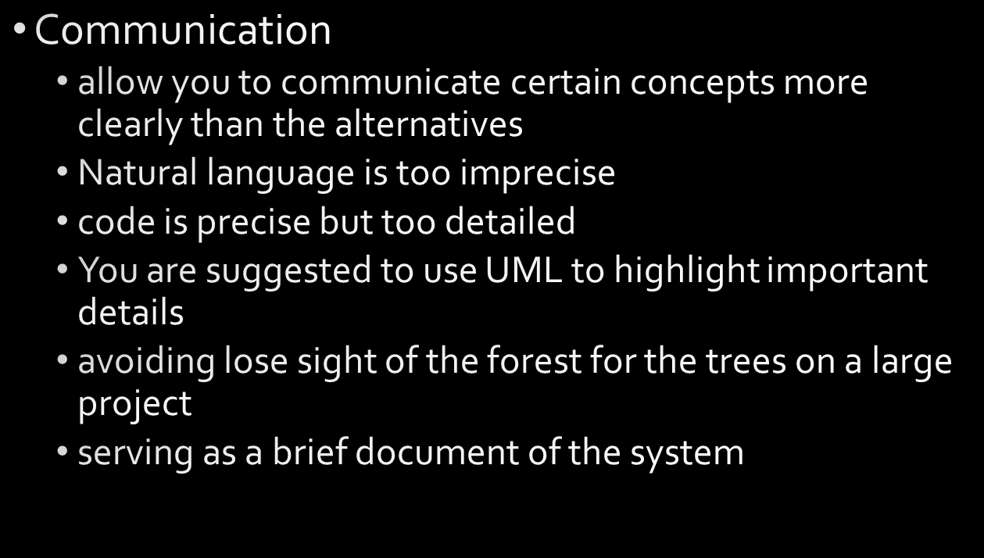

Why you are using UML to do Analysis and Design

Slide 17


Why you are using UML to do Analysis and Design

Slide 18

❶ Jacobson’s Three Types
Interface Objects, Advantages:
Other
Interfaces
Outputs
User Interface
Object Behavior
Object Attributes
Object Classes

Slide 19
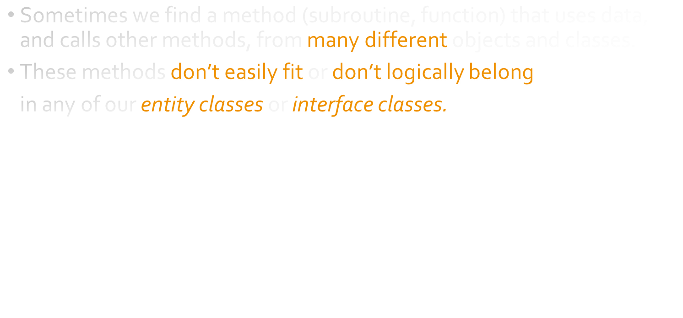

❶  Jacobson’s Three Types
Control Objects:

Slide 20
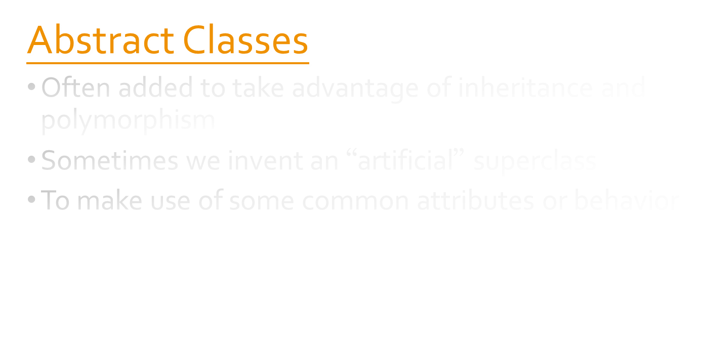

❷ 5.2. Classes and Classification
Additional Data-world Classes

Slide 21
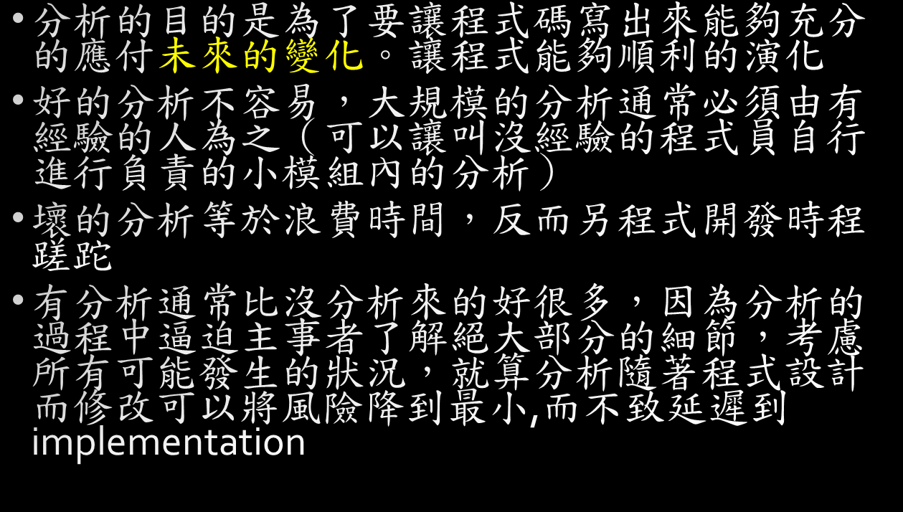

Discussion

Slide 22
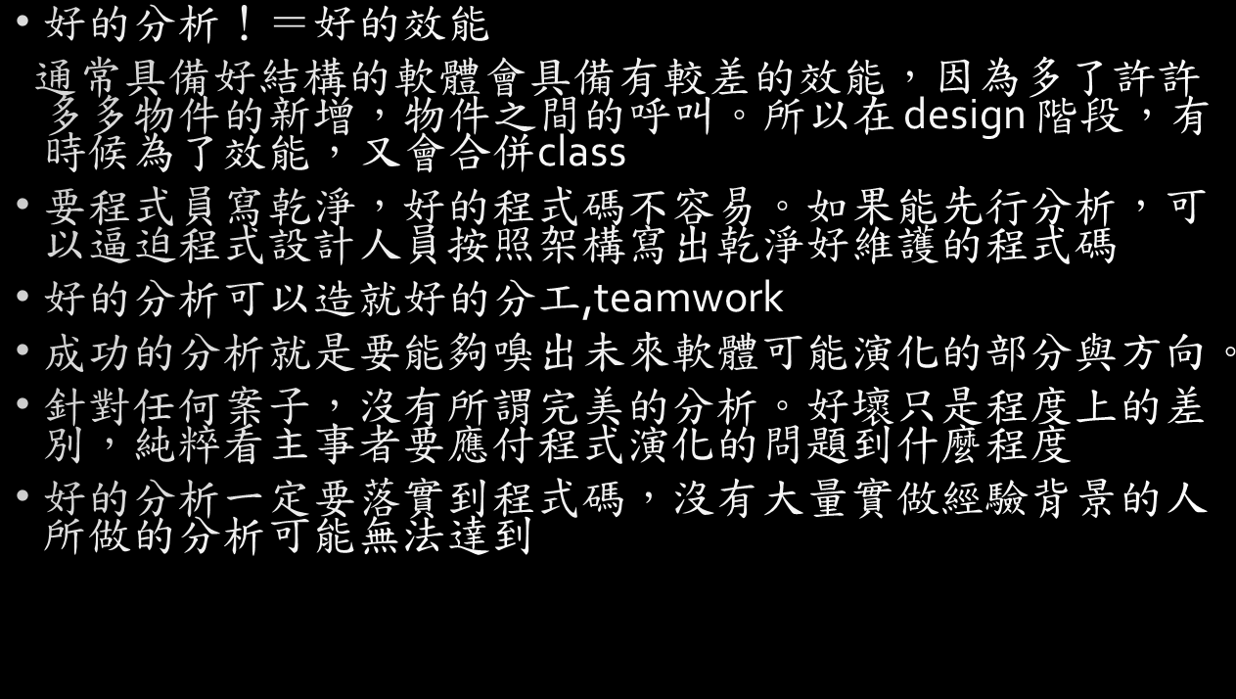

Discussion

Slide 23
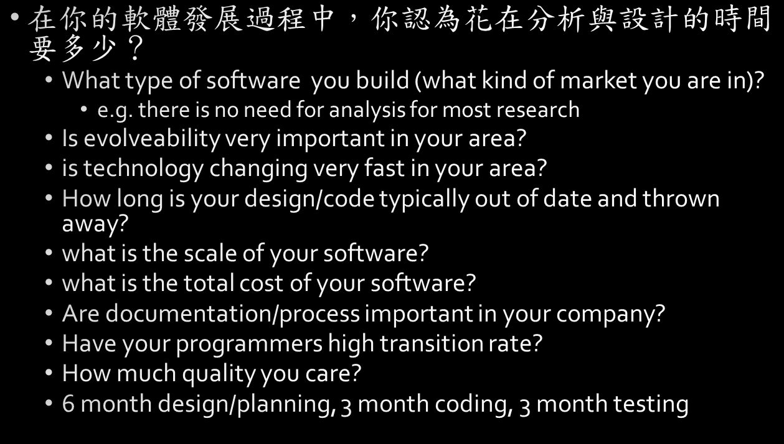

Discussion

Slide 24
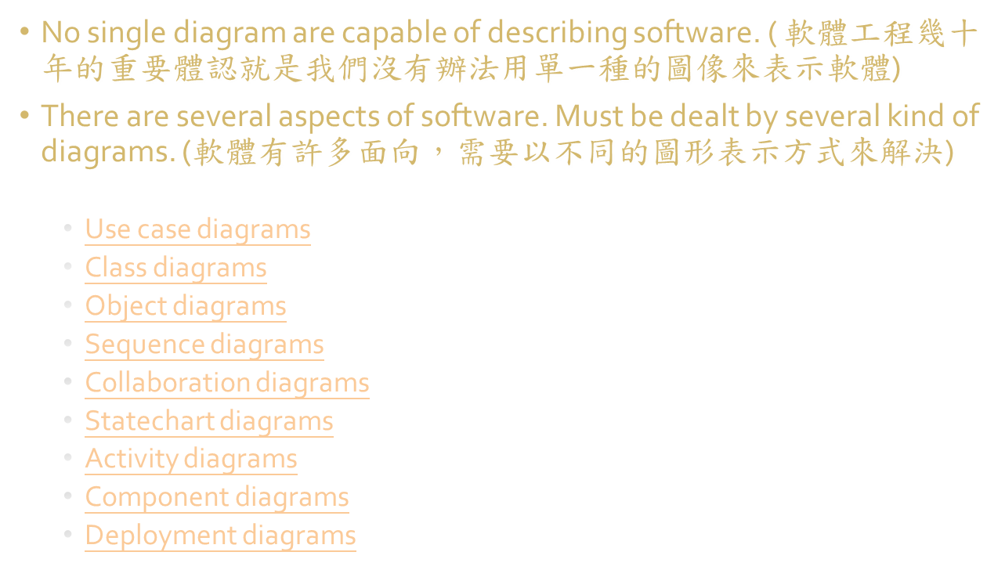

An brief introduction of UML

Slide 25


Use Case Diagram

Slide 26
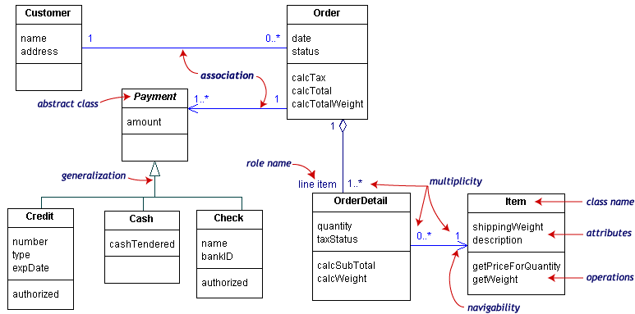

class diagram

Slide 27
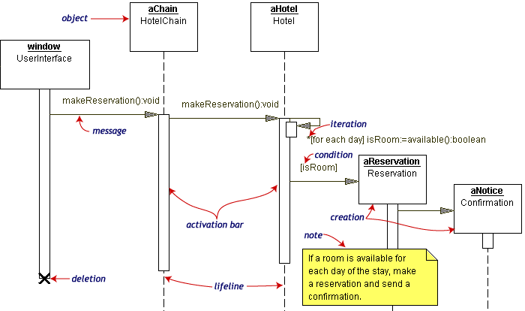

Sequence diagram

Slide 28
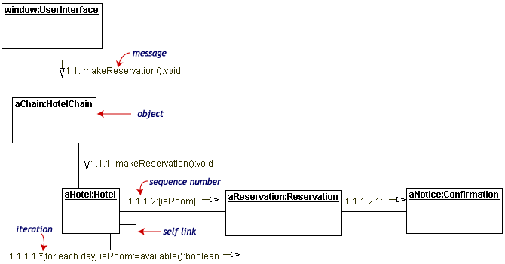

Collaboration diagram

Slide 29
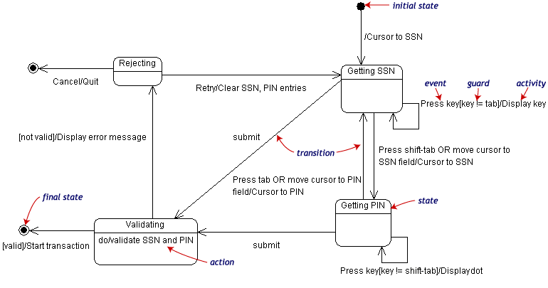

state chart

Slide 30


Activity diagram

Slide 31
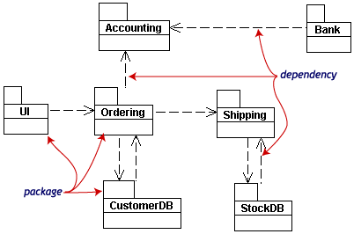

package and object diagram

Slide 32
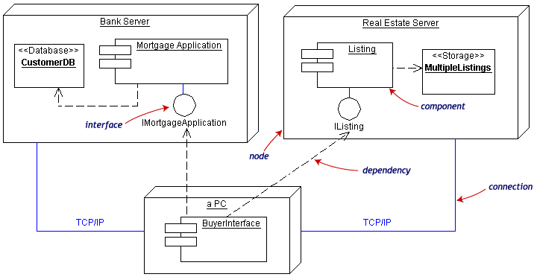

Component and deployment diagram

